Slide 1


Accent Localization Overview and Demo
Presented by:
IT PMO

Slide 2
AI Accent Localization overview
Indian English accent localized to US English accent
﻿Support for Filipino English accent in Early Access stage
﻿No enrollment or model training required
Enforced or manual toggle on/off mode options
﻿Reconstructed natural speech and 0% accent leakage
﻿Multiple male and female voice options
﻿Secure on-device conversion processing
﻿Integrated background noise and voice cancellation
﻿Enterprise-grade deployment, management, and configuration
Support for LatAm English and South African English accents coming soon

Slide 3
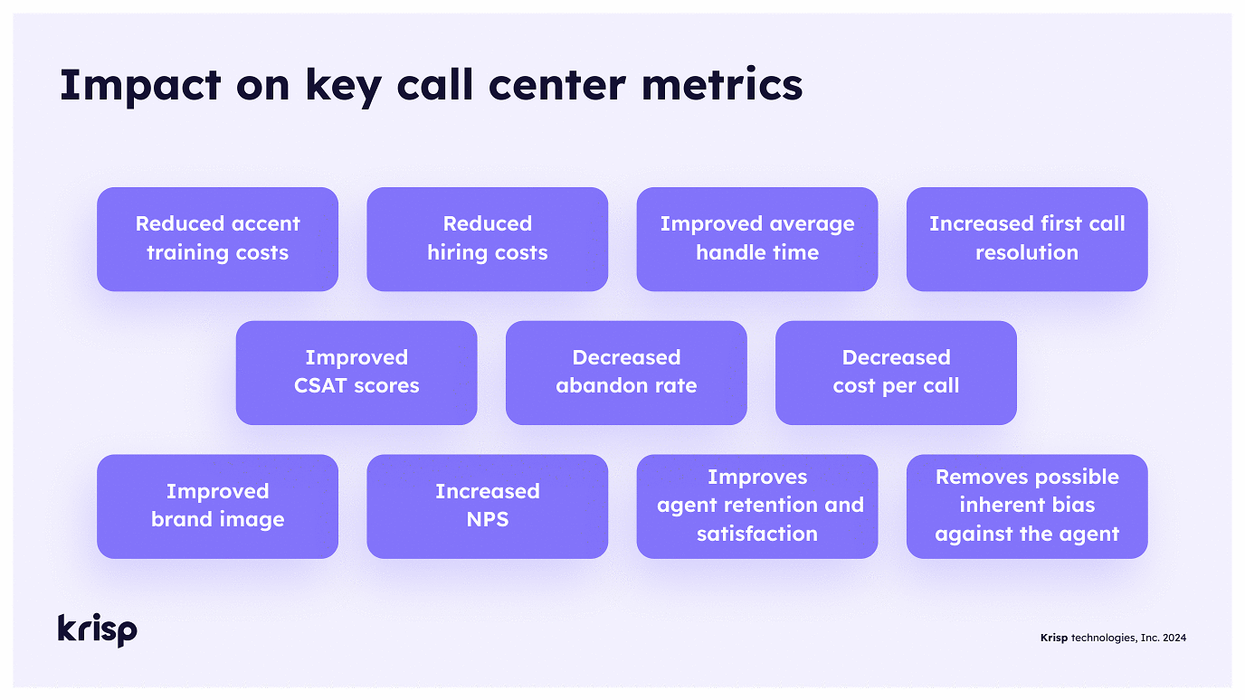

Slide 4
